Slide 1
Unit 1 Review Jeopardy

Slide 2
The Real Number System | Properties of Real Numbers | Order of Operations & Evaluating | Combining Like Terms and Distributive Property | Translating Verbal Expressions
200 | 200 | 200 | 200 | 200
400 | 400 | 400 | 400 | 400
600 | 600 | 600 | 600 | 600
800 | 800 | 800 | 800 | 800
1000 | 1000 | 1000 | 1000 | 1000

Slide 3
Is -7 a natural number?
no
Back

Slide 4
True or false: Whole numbers contain 0
true
Back

Slide 5
Classify 9.81818181…
R, Q
Back

Slide 6
Classify 3:
R, Q, Z, W, N
Back

Slide 7
Order these numbers from least to greatest:
3/4, -6/7, -0.9, -0.5, 0.65
-0.9, -6/7, -0.5, 0.65, 3/4
Back

Slide 8
True/False: (a + b) + c = a + (b + c) is the Commutative Property
False
Back

Slide 9
What property is this an example of?
-2(x - y) = -2x + 2y
Distributive Property
Back

Slide 10
What property is this an example of?
If 7x = 21, then 21 = 7x
Symmetric
Back

Slide 11
What property is this an example of?
If 20 + 4 = 24 and 24 = 6 • 4, then 20 + 4 = 6 • 4
Transitive
Back

Slide 12
Is this an example of the Associative or the Commutative Property?
(7 + a) + b = (a + 7) + b
Commutative
Back

Slide 13
What is the first step in evaluating this expression?
7 squared
Back

Slide 14
Evaluate
6
Back

Slide 15
Evaluate
26
Back

Slide 16
If x = 7, evaluate 21 +x
28
Back

Slide 17
If A = s² + 10, and s = 10, find A.
110
Back

Slide 18
Combine like terms
-4x – 9y
Back

Slide 19
Combine like terms
-9y - 13
Back

Slide 20
7w + 5
How many terms are there?
What are the coefficient(s)?
What are constant(s)?
2
7
5
Back

Slide 21
Simplify
6x + 60
Back

Slide 22
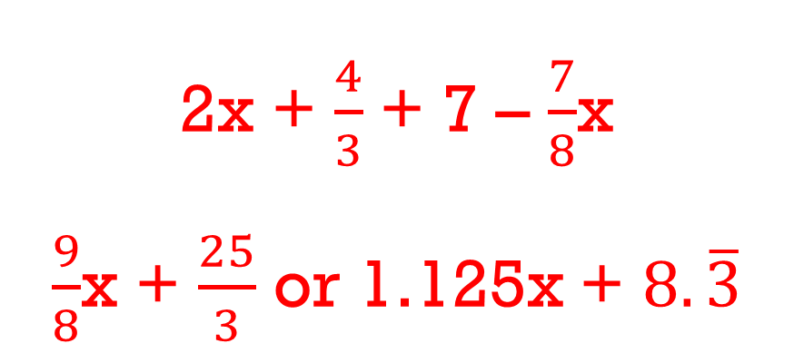
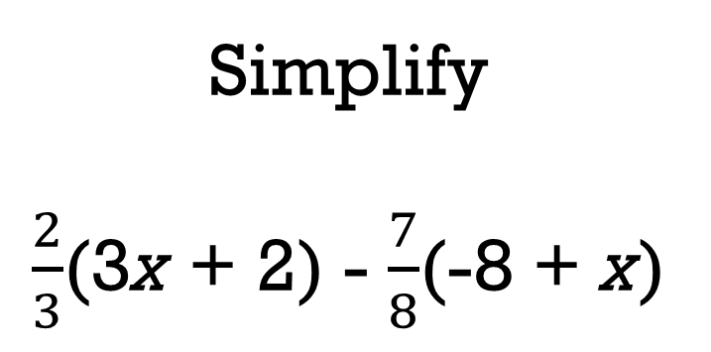
Simplify
$\frac{2}{3}$(3x + 2) - $\frac{7}{8}$(-8 + x)
2x + $\frac{4}{3}$ + 7 – $\frac{7}{8}$x
$\frac{9}{8}$x + $\frac{25}{3}$ or 1.125x + $8.\overline{3}$
Back

Slide 23
Translate
9 + 7
Back

Slide 24
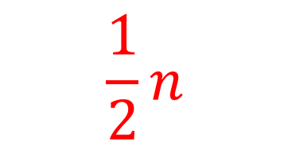
Translate
$$\frac{1}{2}n$$
Back

Slide 25
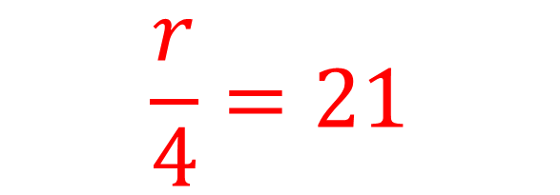
Translate
$$\frac{r}{4}=21$$
Back

Slide 26
Translate
7 less than twice a number and 4
(2n + 4) - 7
Back

Slide 27
Translate
The maximum occupancy is 55
n ≤ 55
Back

